Slide 1


Azure SQL for Beginners Performance Troubleshooting Waiting due to memory grants
Special Edition
#azuresql
aka.ms/azuresql4beginners

Slide 2


Performance is “slow” = Running vs Waiting
Low or
no CPU
High CPU
What queries are the top resource consuming queries or are waiting?

Slide 3



Running vs Waiting Scenarios
High CPU
Waiting
Missing Index
Blocking
Anti-pattern queries
Deadlocks
Lack of resources
Memory Grants

Slide 4
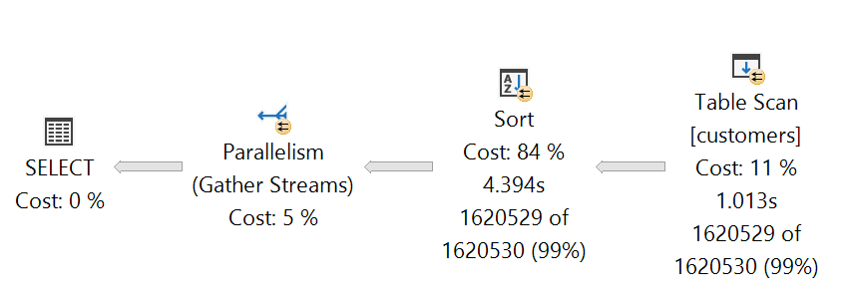
What is a memory grant?
SELECT customer_id, customer_type, customer_date
FROM customers
WHERE customer_date < GETDATE()
ORDER BY customer_date, customer_type
1,000,000, rows x
500 bytes per row
= ~500Mb
Memory Grant
Granted before execution

Slide 5



When can memory grants become a problem?
1,000,000, rows x
500 bytes per row
= ~500Mb
Memory Grant
Granted before execution
RESOURCE_SEMAPHORE
Memory Grant
1Mb
Actual Memory Needed
500Mb
tempdb
IO_COMPLETION
IO_QUEUE_LIMIT
Memory Grant Feedback = Adjust after first execution

Slide 6
The troubleshooting process
You might see Data IO
Identify small, low, or no CPU
Check to see if waits using DMVs
Look at Top Resource Consuming Queries
Look for spills, sorts, hash operations
Add indexes or tune queries to reduce memory grants or size
IO_COMPLETION, IO_QUEUE_LIMIT, or RESOURCE_SEMAPHORE waits may be seen
Enable MGF
dbcompat
Try it yourself at https://aka.ms/azuresqlworkshop

Slide 7
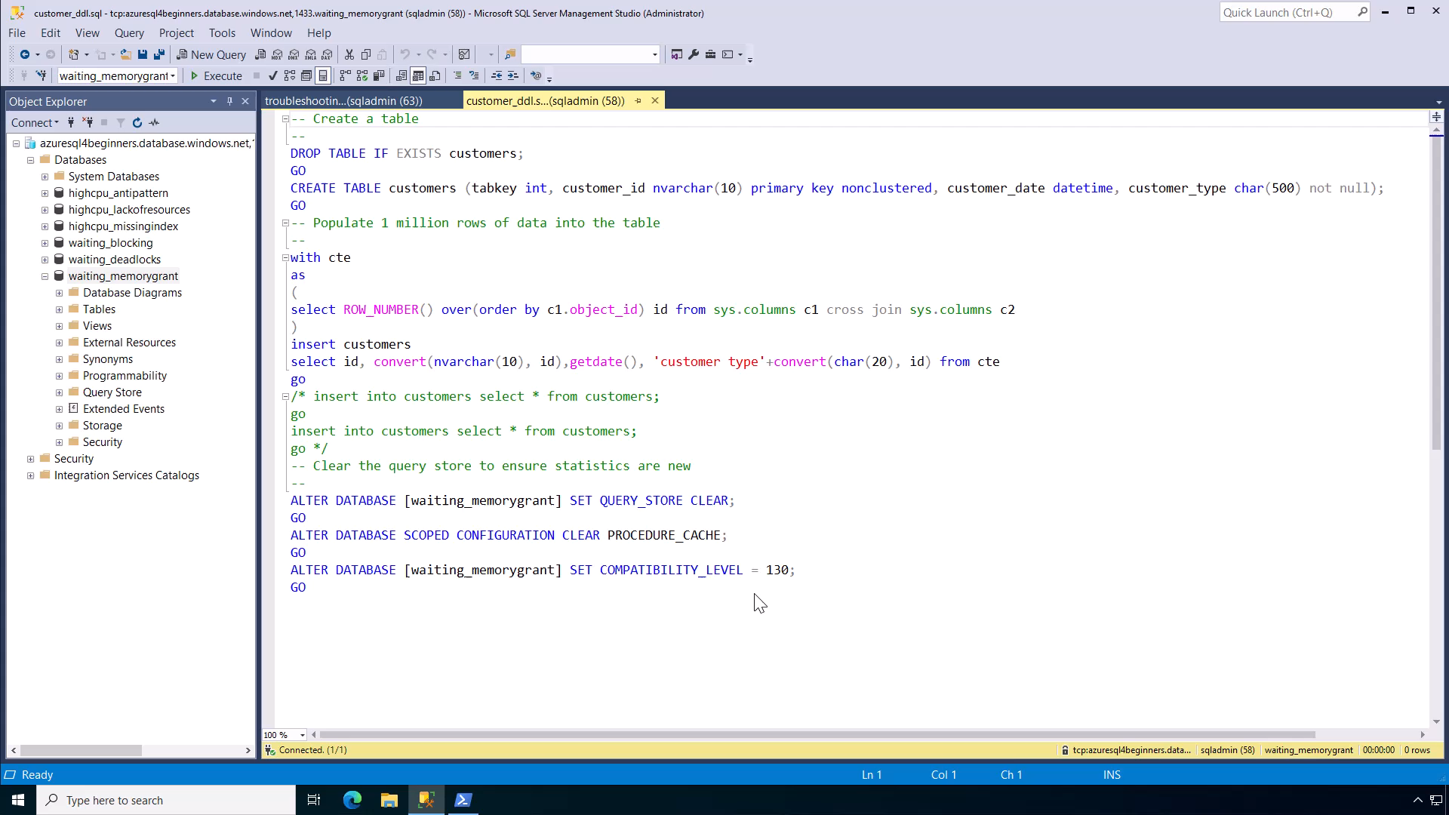
Notes:
30 secs

Slide 8
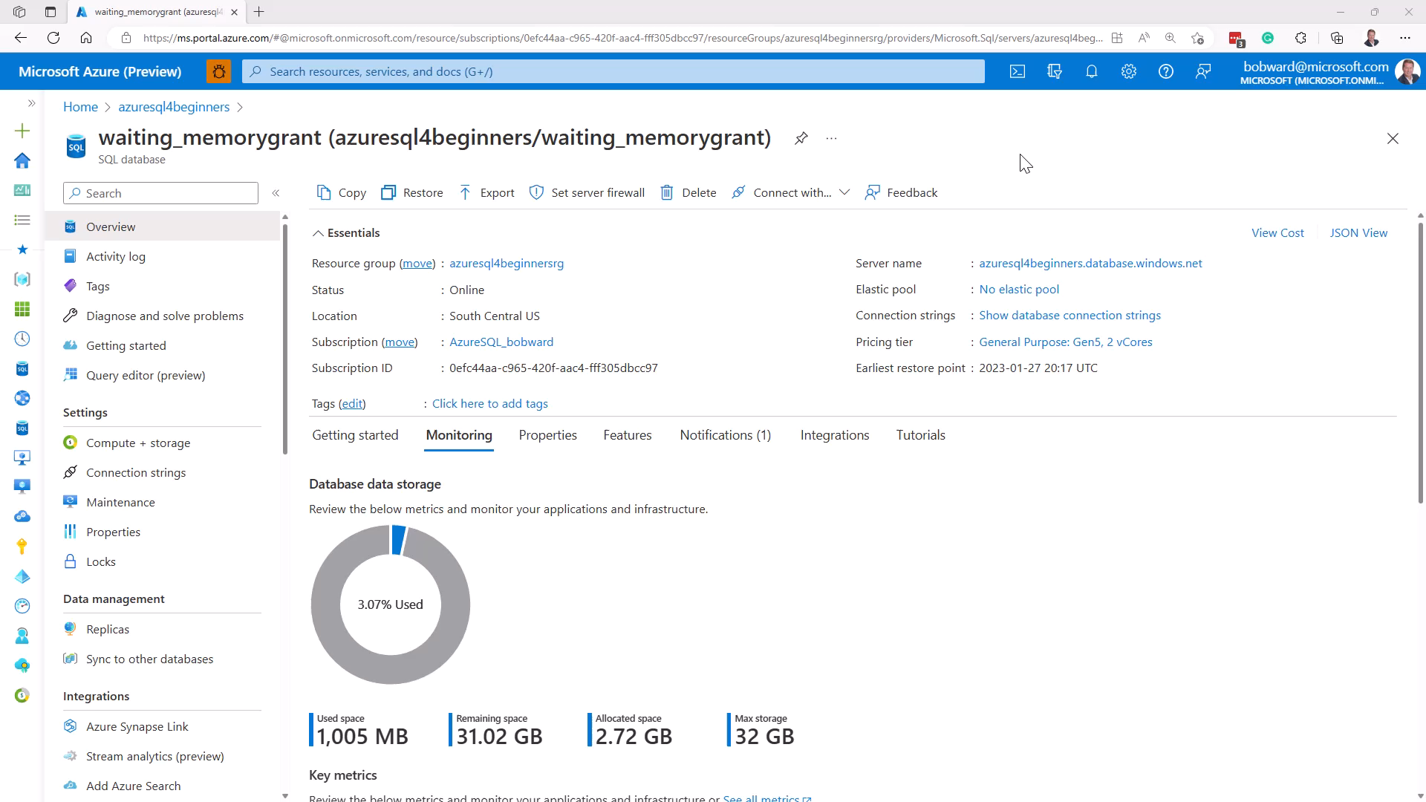
Notes:
30 secs

Slide 9
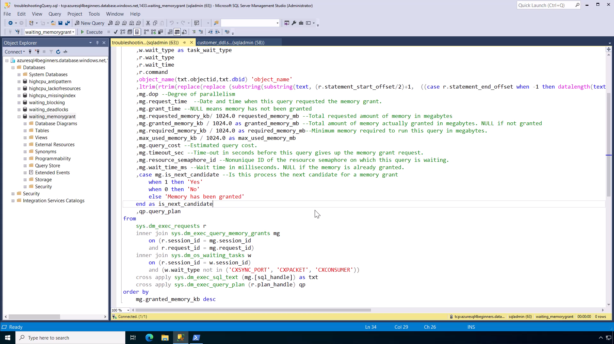
Notes:
30 secs

Slide 10
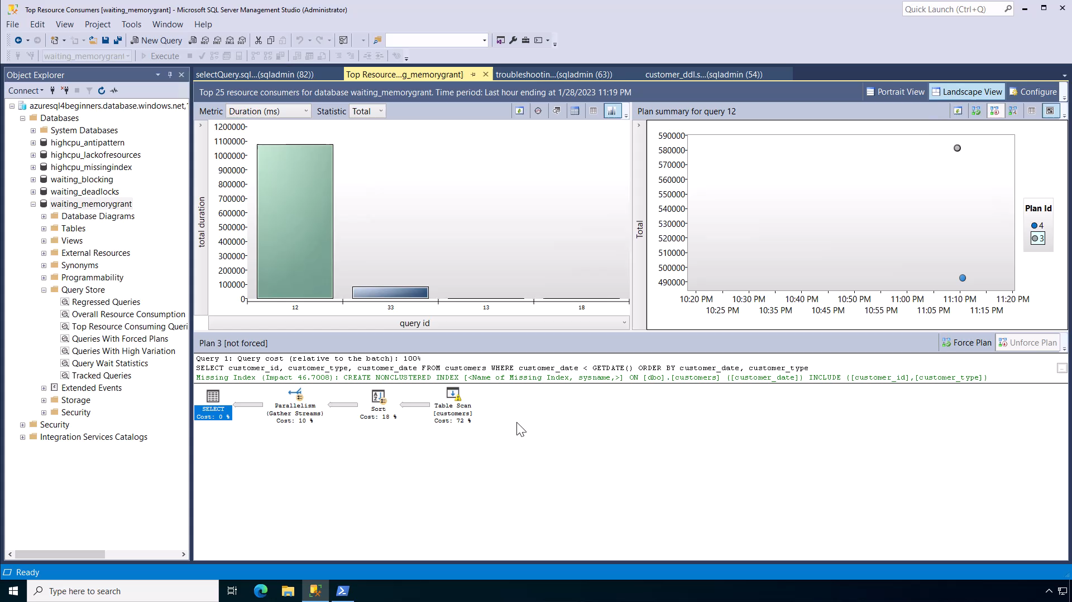
Notes:
1 min

Slide 11
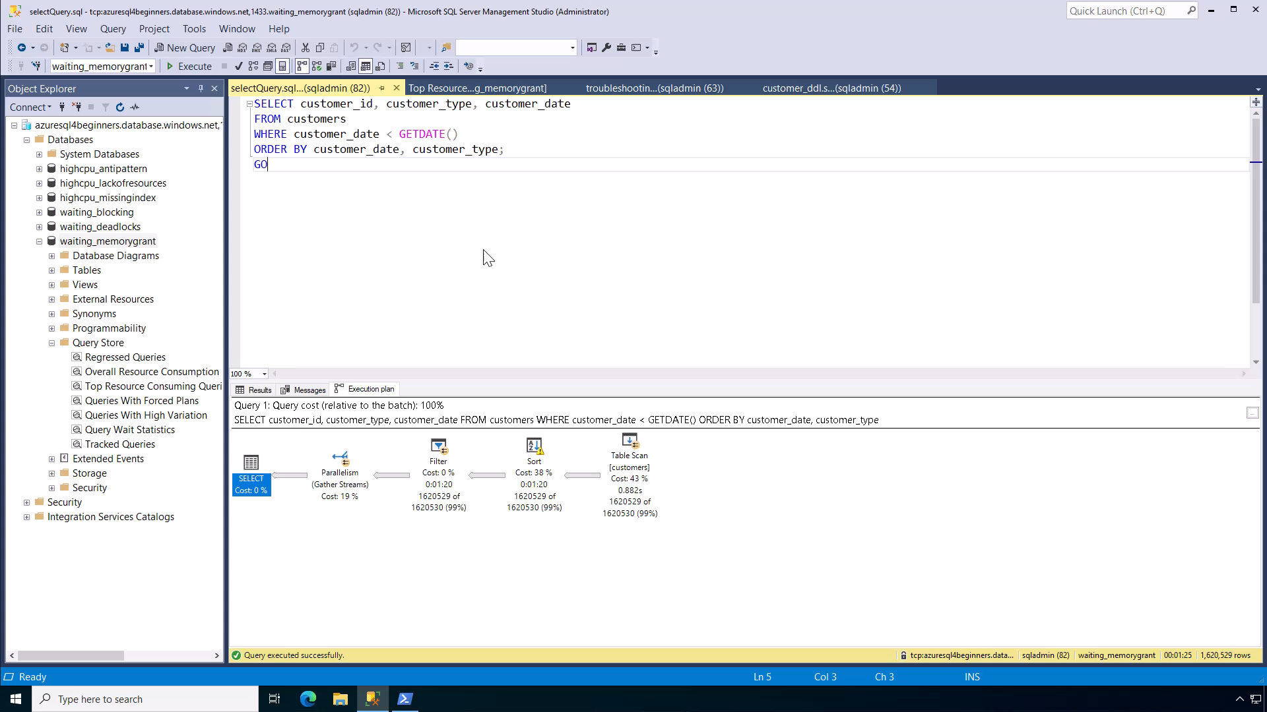
Notes:
30 secs

Slide 12

Notes:
1 min

Slide 13
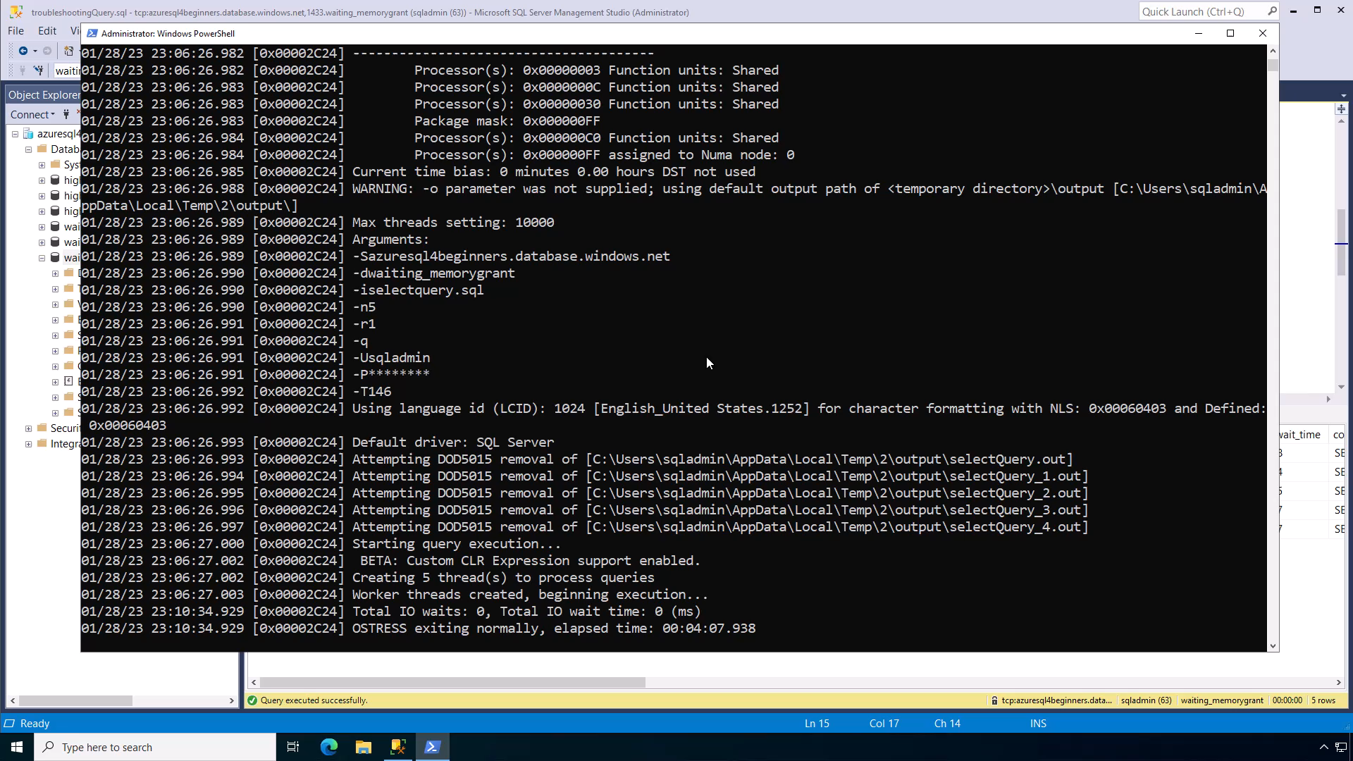
Notes:
1 min

Slide 14
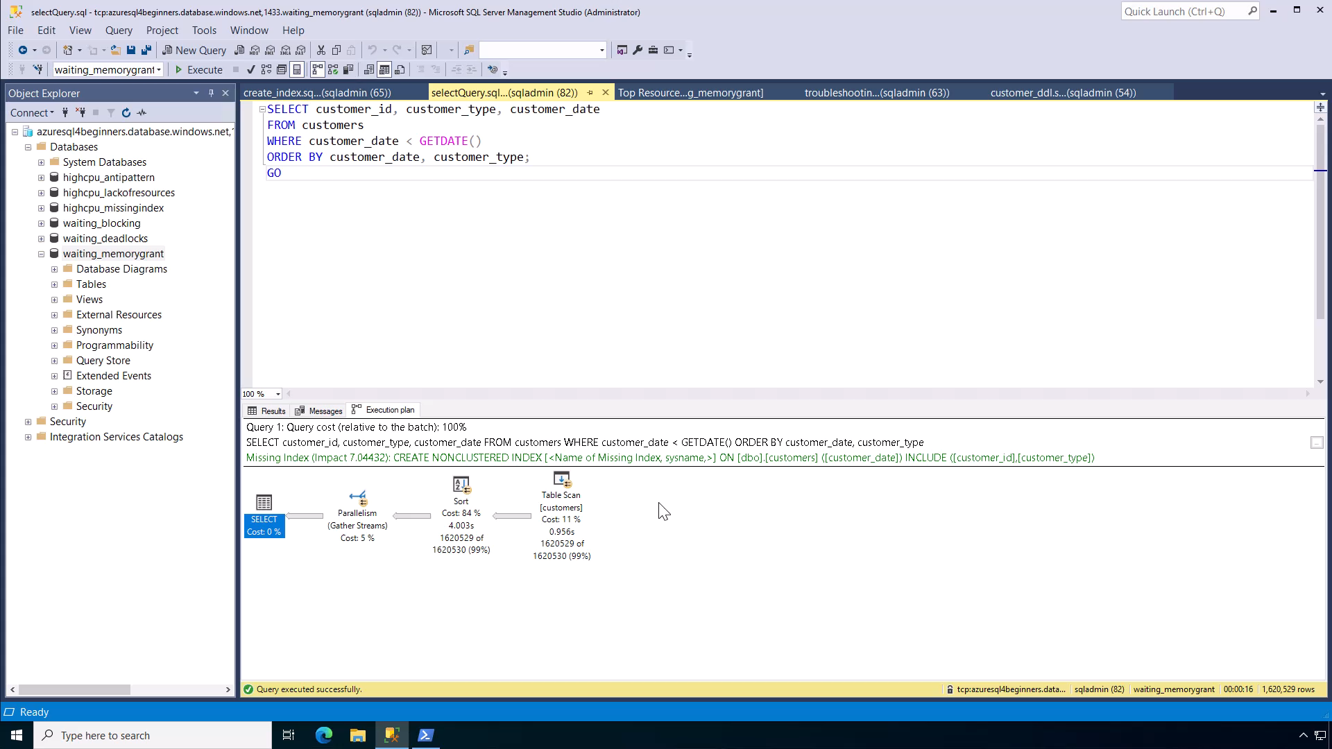
Notes:
1 min

Slide 15
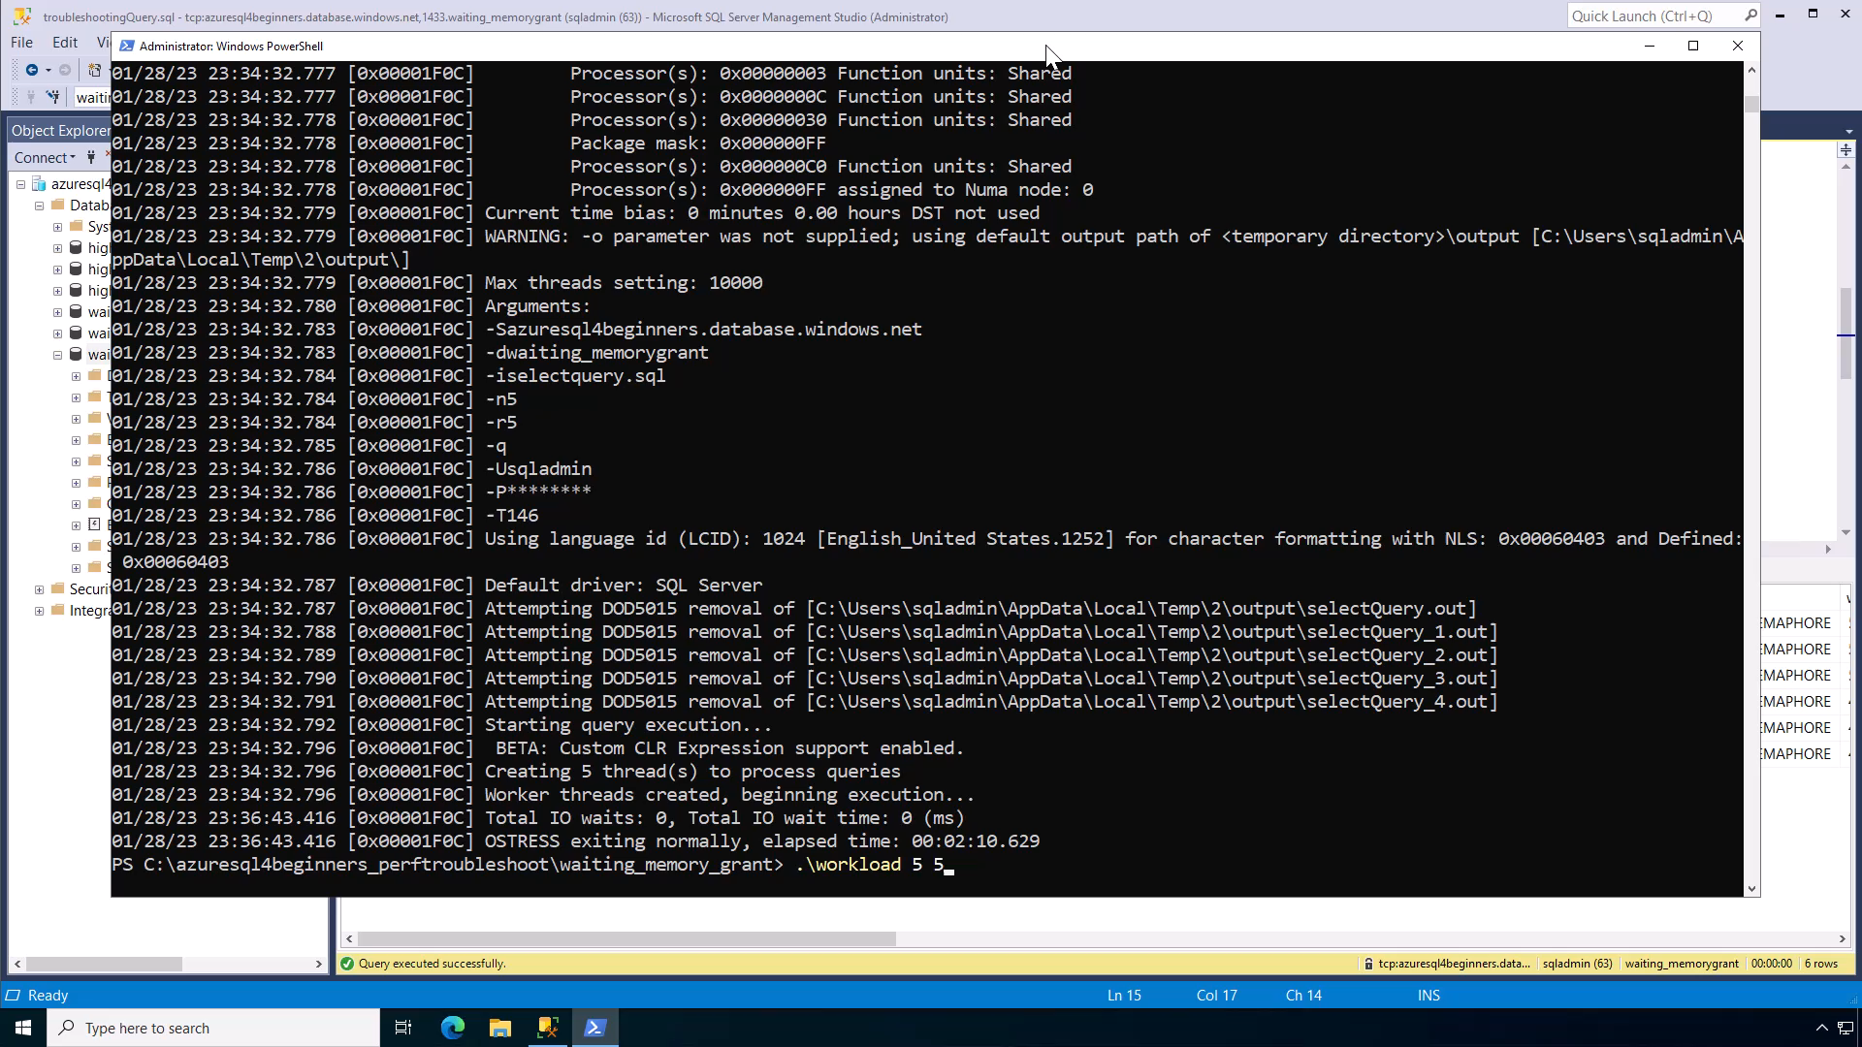
Notes:
30 secs

Slide 16
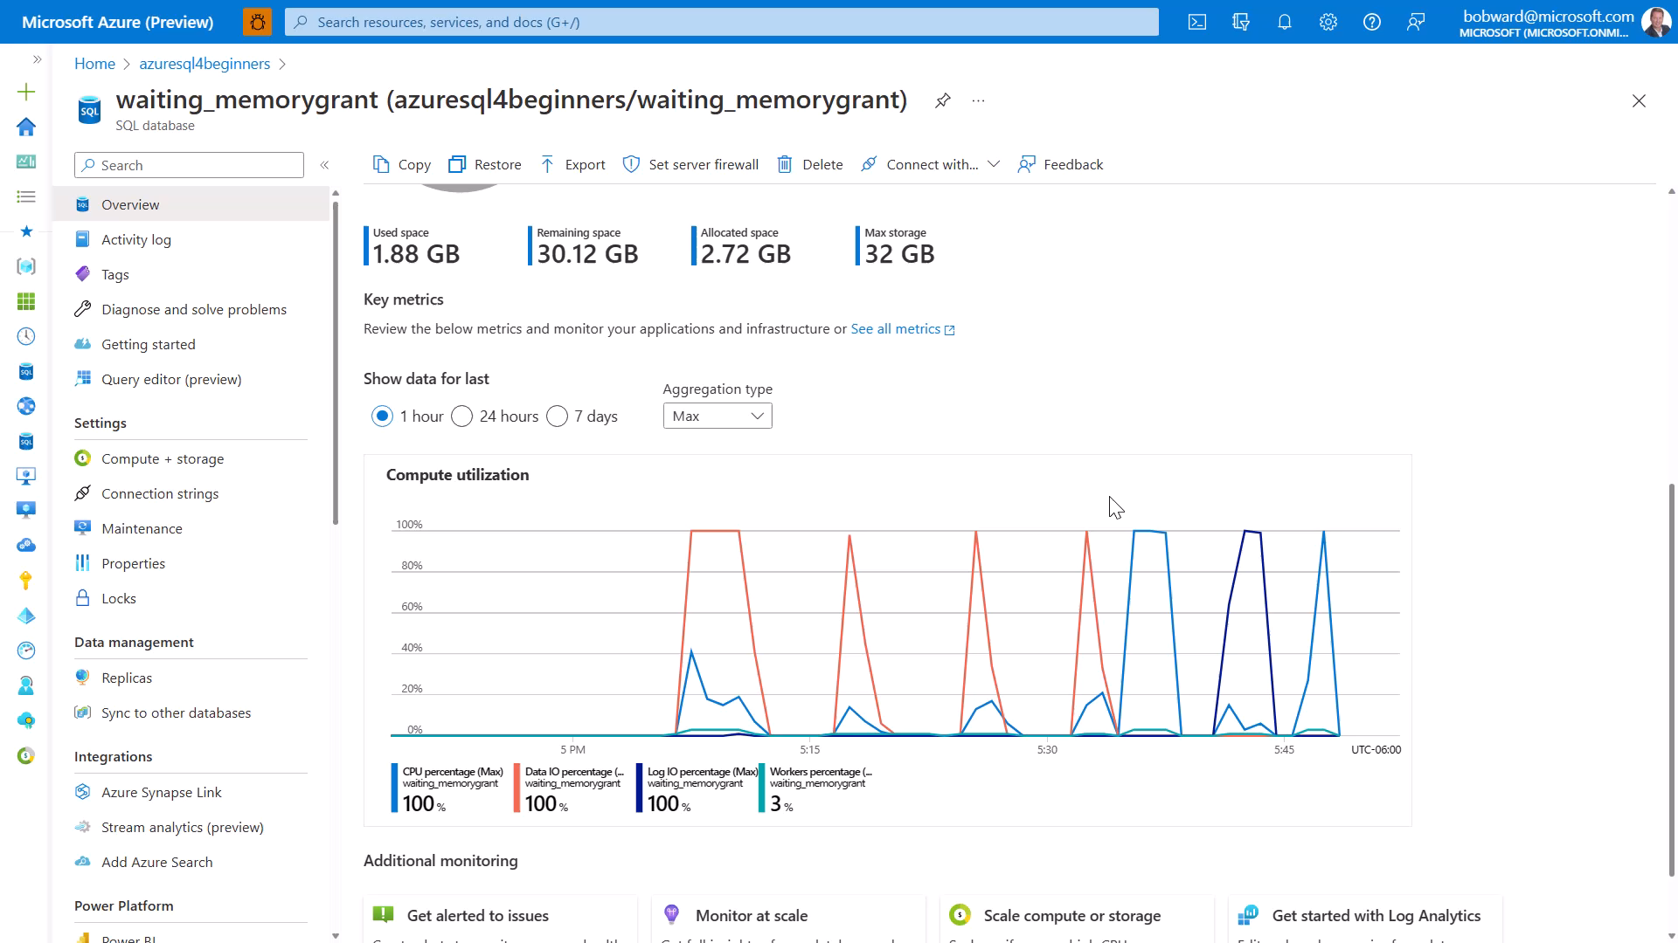
Notes:
1 min
Demo total = 7 mins 30 secs

Slide 17
Summary
SQL performance problems are either running or waiting.
SQL performance problems typically involve finding out what queries are involved.
If you have low or no CPU it could be a waiting problem.
Use Dynamic Management Views (DMV) to check waits. If waits on IO_* or RESOURCE_SEMAPHORE it could be memory grant issue.
Use dbcompat 150 or 160 for memory grant feedback
Use indexes or tune queries to avoid memory grant issues.

Slide 18


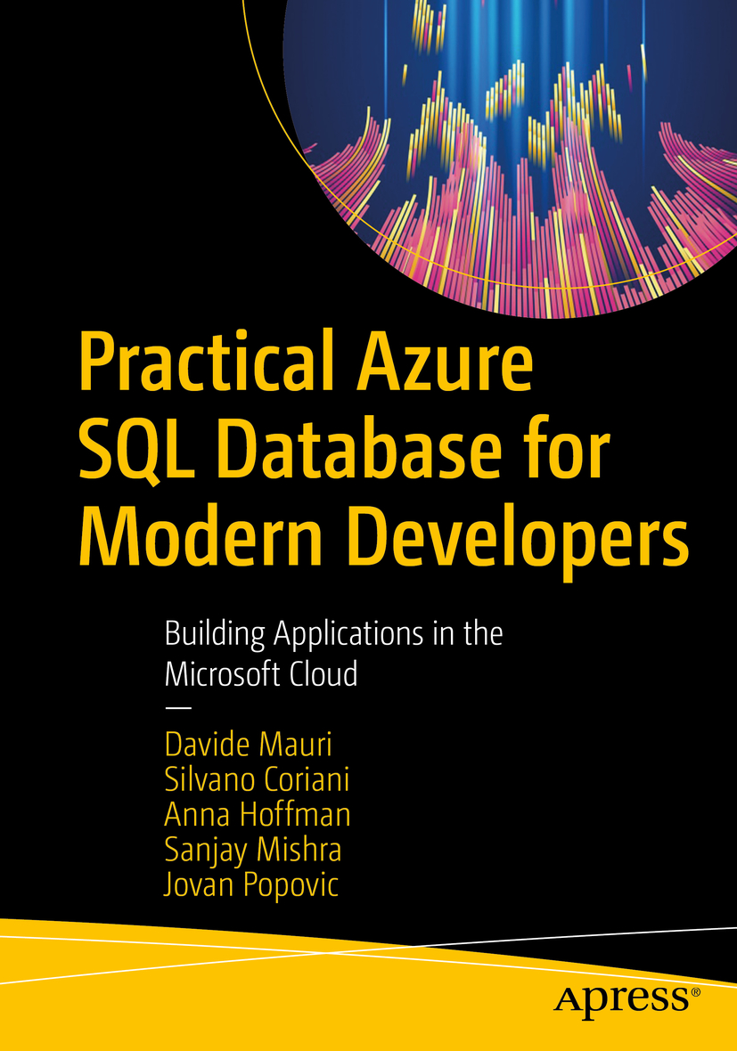


Learn more
Learn more about SQL memory grants
aka.ms/sqlmemorygrant
Azure SQL for Beginners
aka.ms/azuresql4beginners
Azure SQL Workshop
aka.ms/azuresqlworkshop
aka.ms/azuresqlbook
Azure SQL Fundamentals
aka.ms/azuresqlfundamentals
Watch Data Exposed
aka.ms/dataexposed
See more videos from our team
aka.ms/azuresqlyt
Follow us on social media
aka.ms/azuresqltwitter
aka.ms/azuresqlfordevelopers

